Slide 1
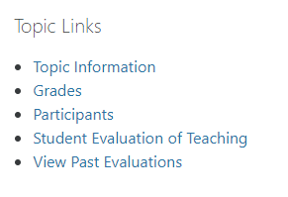
Student Evaluation of Teaching (SET)
In your FLO topic, click (top right corner)
Then under Topic Links, click Student Evaluation of Teaching
Or direct at set.flinders.edu.au
The primary purpose of the Student Evaluation of Teaching
is to provide staff with valid and reliable information with which to make informed decisions
about improving student learning outcomes

